Slide 1
HOME CREDIT DEFAULT RISK
Pooja Dawada
Mohini Agarwal
Sachin Balakrishnan
Anshika Ahuja
Qingzi Zeng

Slide 2
CONTENTS
Problem Statement
Data Description
Data Summary
Hypotheses
EDA
Feature Engineering
Modeling
Results & Insights

Slide 3



PROBLEM STATEMENT
Unbanked / underbanked population stats in US (22% households)
Predicting defaulters without credit score history
Improving the loan application process

Slide 4
Code_gender column discarded
Application {Train | Test}
Main tables (with binary Target variable)
Information about loan and applicant at application time
Unique at LOAN_ID level
Current Load ID
Current Load ID
POS_CASH_Balance
Monthly balance of client’s previous loans in Home Credit
Behavioral Data
Current Load ID
Bureau
Application data from previous loans for the client reported by Credit Bureau
Unique at all previous Loan ID level
Previous Applications
Application data from previous loans for the client reported by Credit Bureau
Unique at all previous Loan ID level
Installment Payments
Past payment data for each installments of previous credits in Home Credit related to loans in our sample
Previous Load ID
Bureau ID
Bureau Balance
Monthly balance of credits in Credit Bureau
Status of Credit Bureau loan during the month
Credit Card Balance
Monthly credit of client’s previous credit loans in Home Credit

Slide 5
DATA SUMMARY
Number of applicants - 350k
Number of features for every applicant - 121
Number of bureau features - 17
Number of credit features - 23
Number of previous application features - 37
Other features - 16

Slide 6
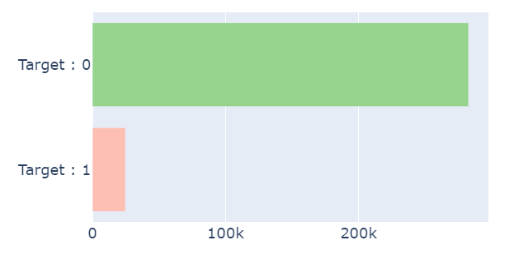
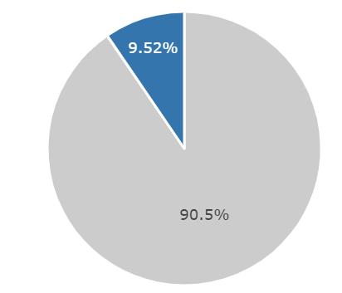

HYPOTHESES
People who own a car or House default less
Older people default less
Higher income group people default less
People with a higher education would default less

Slide 7
Base tables EDA

Slide 8
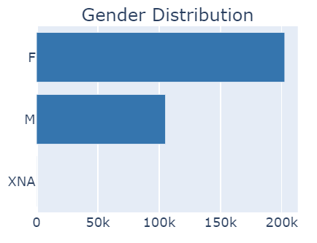
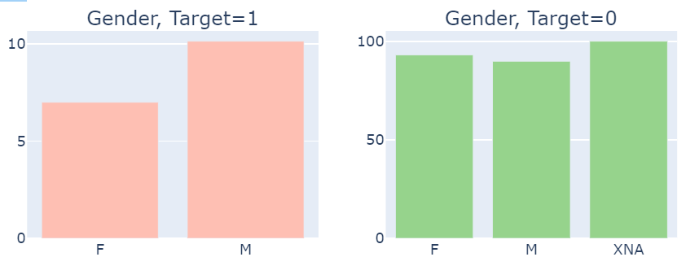
EDA - Gender
It is illegal to use gender in deciding whether to give loans
We will be removing this variable in the prediction even though it seems to have an impact

Slide 9
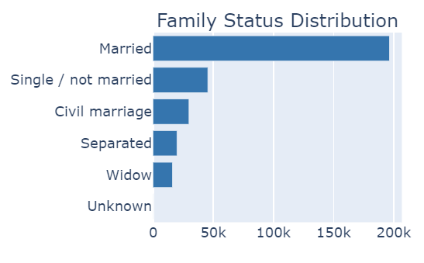
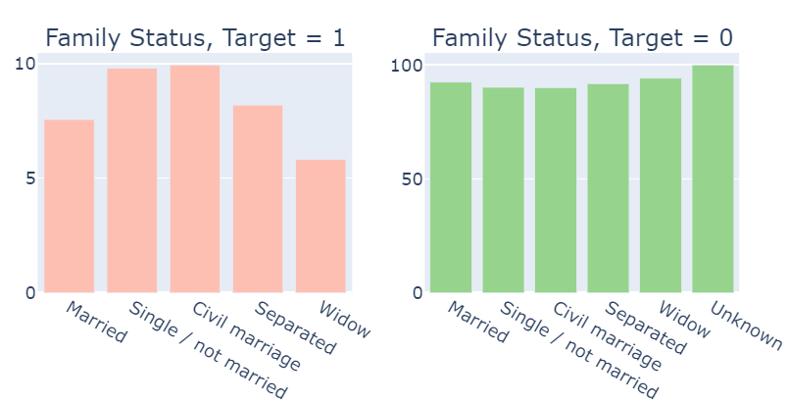
EDA - Family Status
Single/Civil Marriage applicants default more
Might be a proxy for age

Slide 10
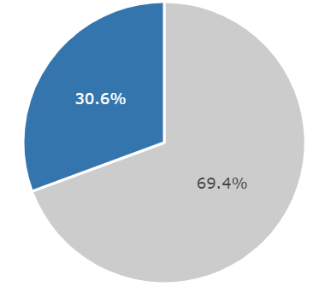
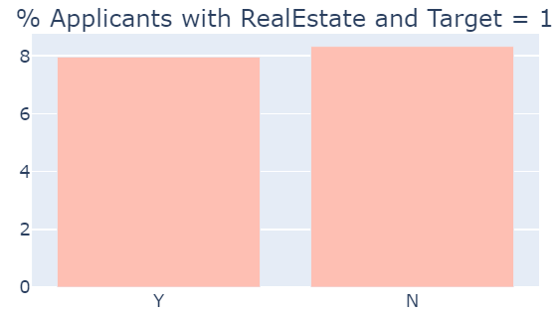

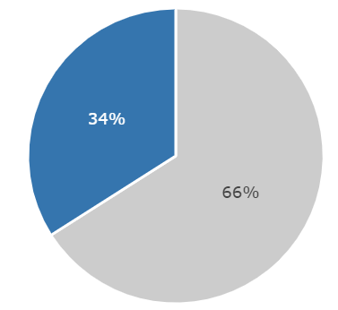
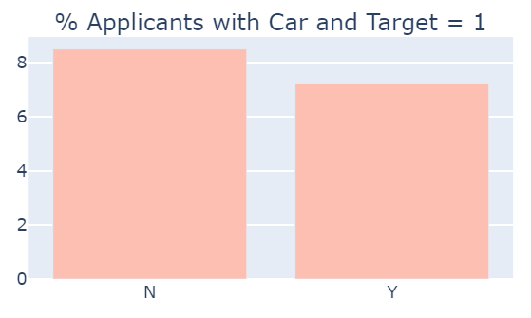
EDA - Realty and Car
70% of the applicants own realty
66% own a car.
People who don’t own a property or a car are likely to default more

Slide 11
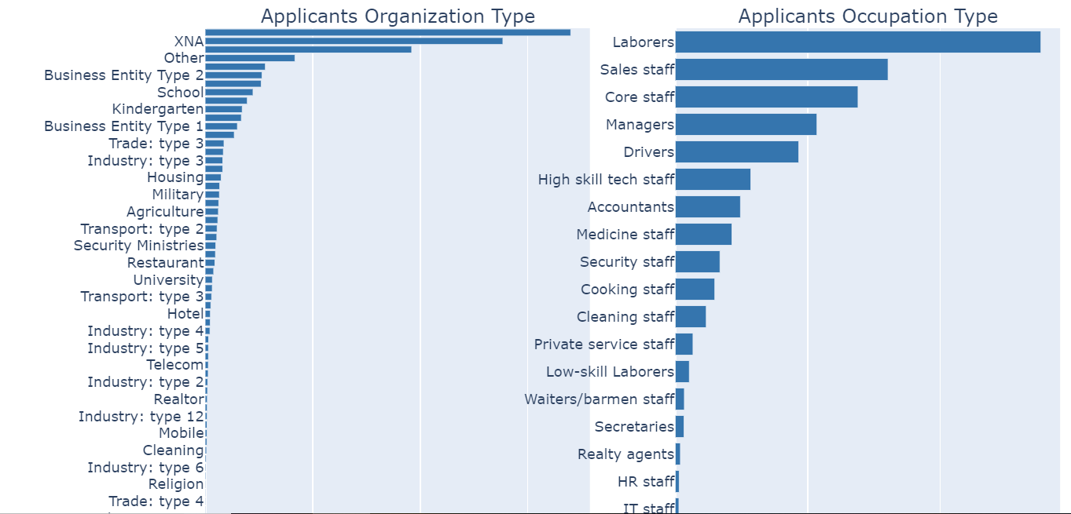
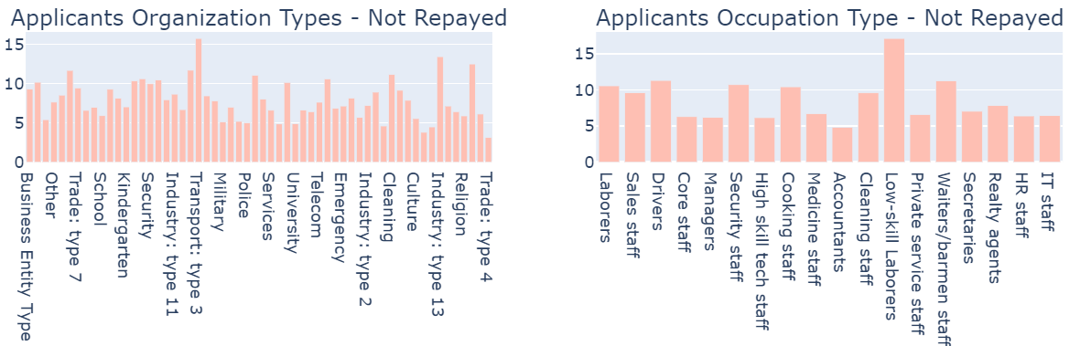
EDA - Organization and Occupation
Applicants:
Organization type:
Business Entity Type 3
XNA
Self employed
Occupation Type:
Top : Laborers, Sales staffs
Bottom: IT domain.
Defaulters:
Organization type
Transport type 3 organization (15%).
Industry type 13, construction.
Occupation Type:
Low skill laborers (17%).
Least probable - Accountants, IT staff, high skilled laborers.

Slide 12
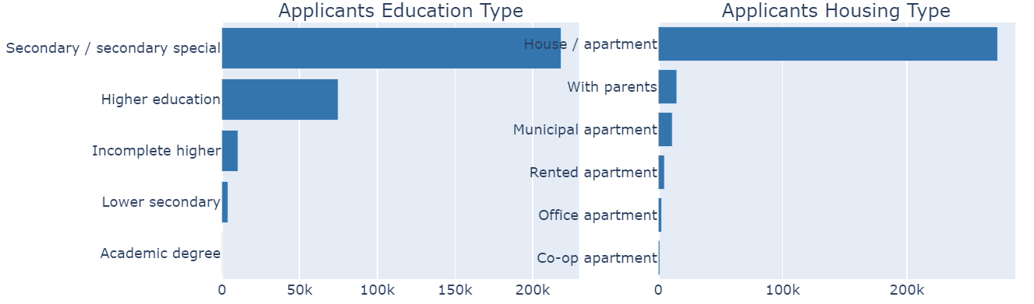
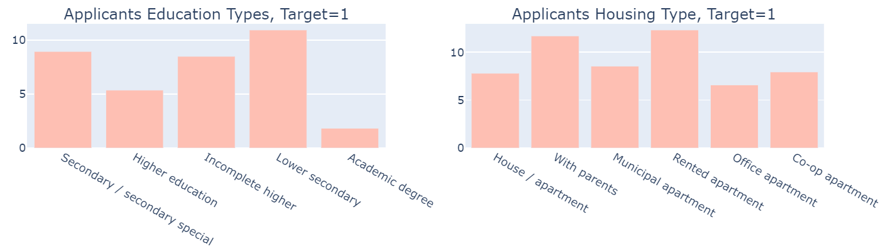
EDA - Education and Housing
Applicants:
Secondary education(218K) followed by people with Higher Education(75K)
Living in House / apartments (272K)
Defaulters:
Lower Secondary /Secondary/ Incomplete education
Living in rented apartments or living with parents

Slide 13
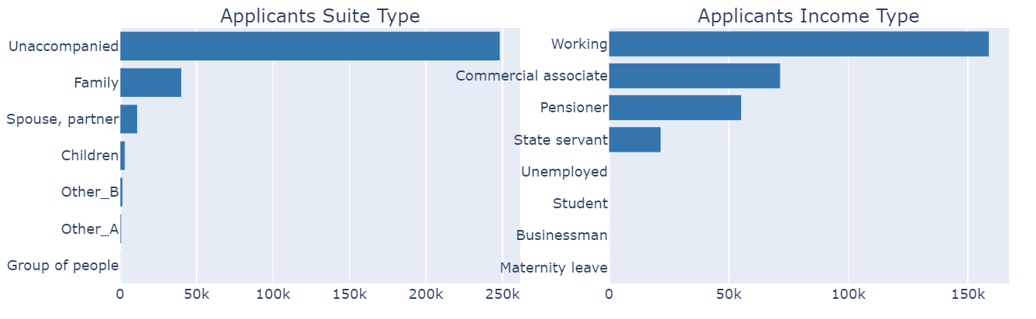
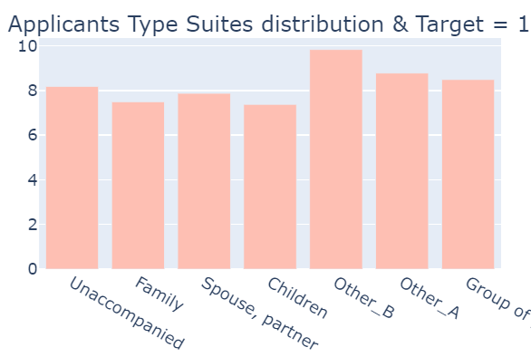
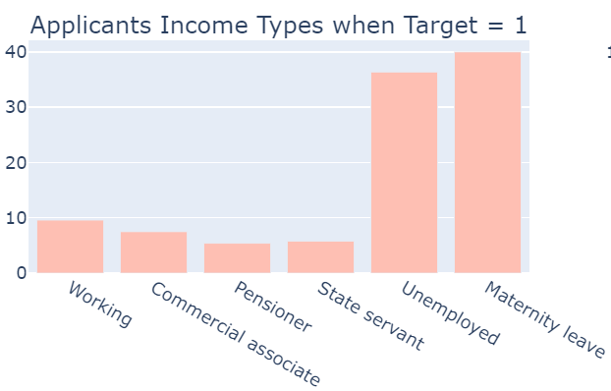
EDA - Suite type and Income
Applicants Suite Type:
A slight peak at 'Other_B'(10%).
Rest all are concentrated around the 8% mark.
Applicants who were accompanied by children are the least likely to default
Income Type:
Unemployed applicants are likely to default more.
Applicants who are on maternity leave have the highest % of defaulters!
Students and Businessmen have almost 100% certainty of repayment.

Slide 14
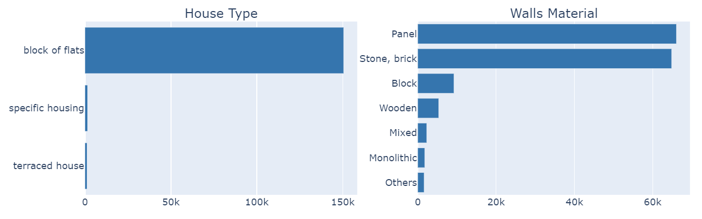
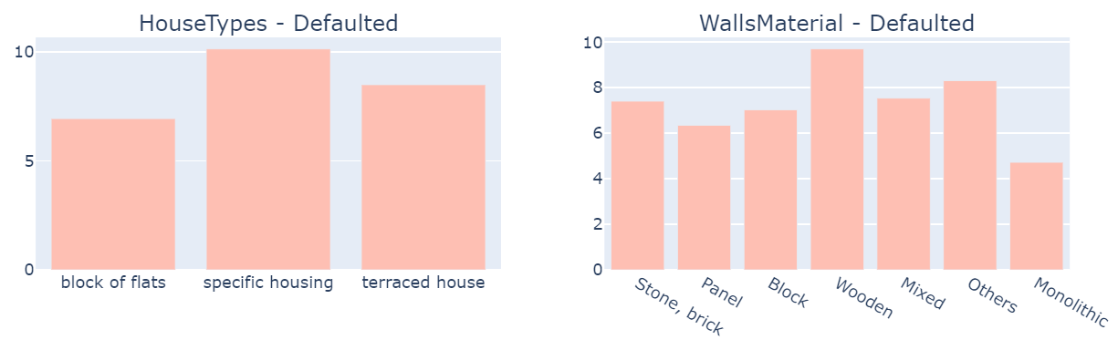
EDA - House Type
People living in block of flats have filed the highest number of loans, but they default less
Specific housing applicants default the most
Panel, stone, brick comprise the bulk of wall materials
People with wooden houses default the most

Slide 15
EDA – Credit History Tables

Slide 16
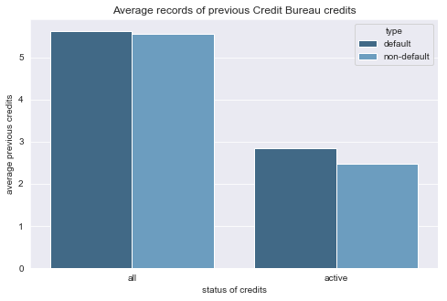
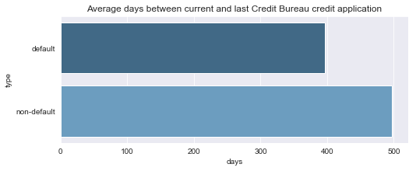
EDA – Previous Credits from Credit Bureau
Number of previous credits a client had in Credit Bureau
- Default: 5.62
- Non-default: 5.55
Number of previous active credits a client had in Credit Bureau
- Default: 2.84
- Non-default: 2.47
Who is most likely to default on loans?
Clients with more active credits in Credit Bureau,
Clients who applied for Credit Bureau credits less than 400 days before current application
Table name: bureau, application
Key: SK_ID_CURR

Slide 17
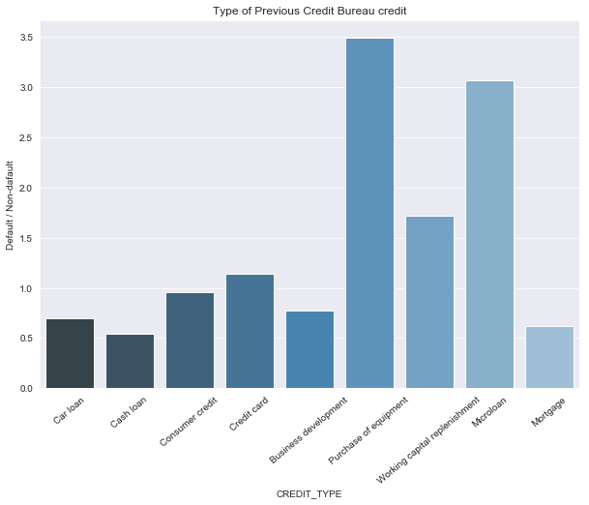
Does the type of previous credits a client have affect his/her default possibilities on current loan?
Loans with high default possibilities:
Loan for the purchase of equipment
Microloan
Loan for working capital replenishment
Loans with low default possibilities:
Cash loan
Mortgage
Car loan
Table name: bureau, application
Key: SK_ID_CURR

Slide 18
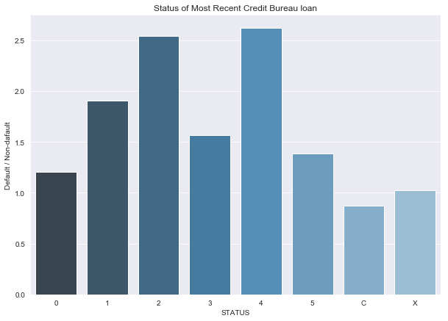
EDA – Previous Credits from Credit Bureau
More than 97% loans are in status C, 0 or X
If a client default on previous loans(DPD 1-120+)), he/she also is very likely to default on current loans
C means closed, X means status unknown, 0 means no DPD, 1 means maximal did during month between 1-30, 2 means DPD 31-60,… 5 means DPD 120+ or sold or written off
Table name: bureau, bureau_balance, application
Key: SK_ID_CURR, SK_BUREAU_ID

Slide 19
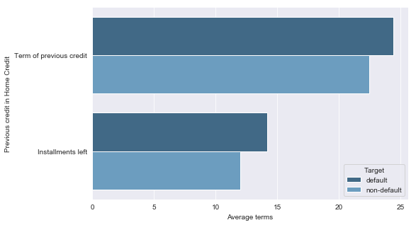
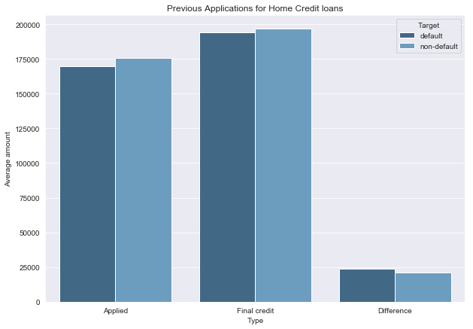
EDA – Previous Credits from Home Credit
Defaulters have previous loans with longer repayment terms and longer installments left to pay on the previous credit
Defaulters applied for less loans, but got approved for more(why?)
difference ~ $3,157
Table name: previous_application,POS_CASH_balance, application
Key: SK_ID_CURR

Slide 20
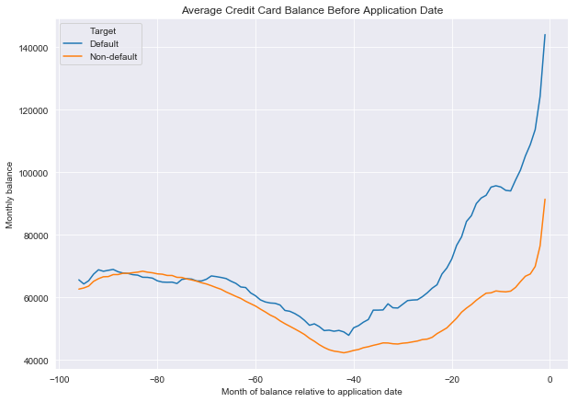
EDA – Previous Credits from Home Credit
Credit card balances for both defaulters and non-defaulters drop between the 100th month and 40th month before current application and increase afterwards.
Defaulters have higher credit card balance.
Table name: credit_card_balance, application
Key: SK_ID_CURR

Slide 21
Data Imputation and Feature Engineering

Slide 22
DATA IMPUTATION
(Application data)
Imputations based on Household Type columns
COMMONAREA
APARTMENTS
NONLIVINGAPARTMENTS
LIVINGAPARTMENTS
FLOORSMIN
YEARS_BUILD
ENTRANCES
BASEMENTAREA
NONLIVINGAREA
LIVINGAREA
FLOORSMAX
TOTALAREA
ELEVATORS
Imputed with -0.1 when HOUSEHOLD_TYPE is null and with 0 when HOUSEHOLD_TYPE is not null. We used the median value columns
Why?
When HOUSEHOLD_TYPE is null it implies that the user doesn’t own any house. Therefore, to signify that we imputed with -0.1

Slide 23
DATA IMPUTATION
(Application data)
Imputations based on Flag_Own_Realty column
LANDAREA
Imputations based on Flag_Own_Car column
OWN_CAR_AGE
Imputed with -0.1 when FLAG_OWN_REALTY is null and with 0 when FLAG_OWN_REALTY is not null. We used the median value columns.
Imputed with the max value of Own_Car_Age column when Flag_Own_Car is not null which signifies that the user owns an old car. Whereas imputed with the max+1 value of Own_Car_Age columns when Flag_Own_Car columns is null which signifies that not having a car is equivalent to having a very old car

Slide 24
DATA IMPUTATION
(Application data)
Imputations based on no condition
CNT_FAM_MEMBERS
AMT_GOODS_PRICE
AMT_ANNUITY
DAYS_LAST_PHONE_CHANGE
YEARS_BEGINEXPLUATATION_MEDI
EXT_SOURCE_1
EXT_SOURCE_2
EXT_SOURCE_3
AMT_REQ_CREDIT_BUREAU_DAY
AMT_REQ_CREDIT_BUREAU_HOUR
AMT_REQ_CREDIT_BUREAU_MON
AMT_REQ_CREDIT_BUREAU_QRT
AMT_REQ_CREDIT_BUREAU_WEEK
AMT_REQ_CREDIT_BUREAU_YEAR
ANNUITY_INCOME_PERCENT
CREDIT_TERM
Imputed with value 0 since we do not have much information about these features

Slide 25
FEATURE ENGINEERING
(Application data)
New Columns
NEW_FLAG
CNT_SOCIAL_CIRCLE_30
CNT_SOCIAL_CIRCLE_60
NEW_FLAG
CNT_SOCIAL_CIRCLE_30 = DEF_30_CNT_SOCIAL_CIRCLE/ OBS_30_CNT_SOCIAL_CIRCLE
CNT_SOCIAL_CIRCLE_60 = DEF_60_CNT_SOCIAL_CIRCLE/ OBS_60_CNT_SOCIAL_CIRCLE
Dummy Encoding
HOUSEHOLD_TYPE
OCCUPATION_TYPE
WALLS_MATERIAL
NAME_TYPE_SUIT
Conversion to Binary
FLAG_OWN_REALTY
FLAG_OWN_CAR
FLAG_OWN_REALTY | HOUSEHOLD_TYPE | NEW_FLAG
Y | NULL | Rent
Y | NOTNULL | Own
N | - | No House

Slide 26
Modeling

Slide 27
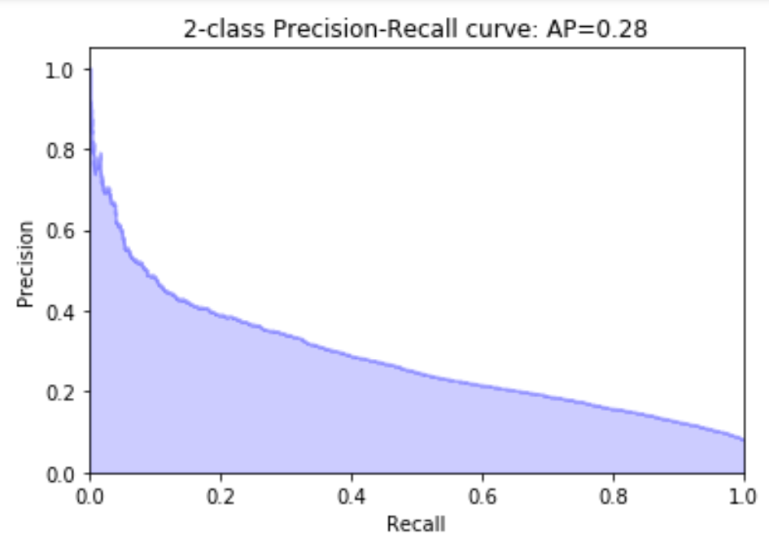
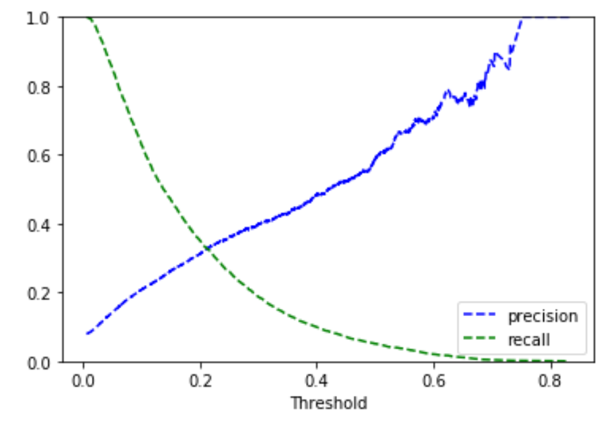
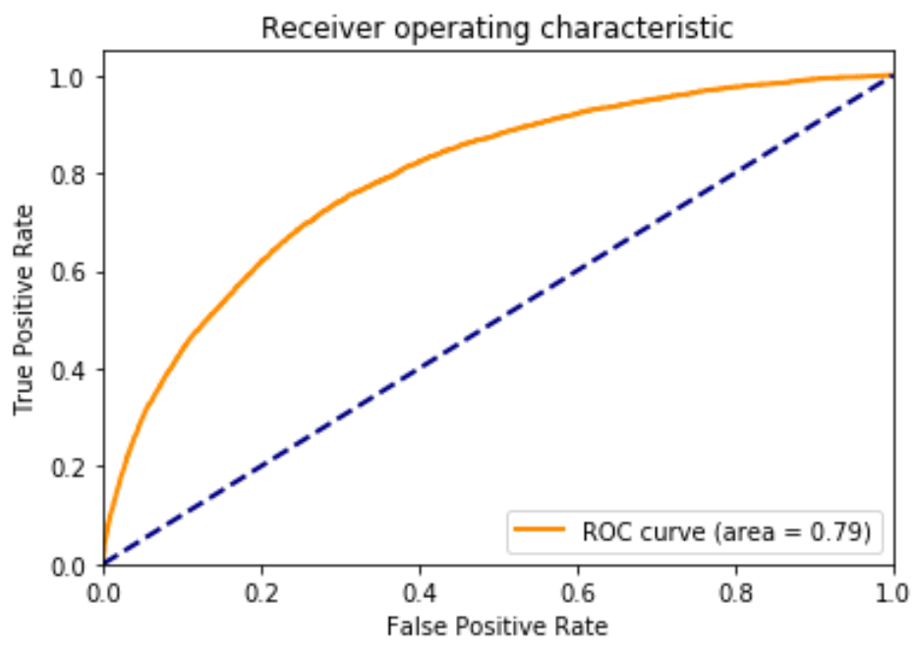
MODELING – LightGBM
(post feature engineering)
Metrics | Model Performance
Full Training score | 0.788
Full Testing score | 0.791
Average Precision Score | 0.28
Accuracy Score | 0.92
True vs. Pred | PP | PN
TP | 56,216 | 392
TN | 4,490 | 411

Slide 28
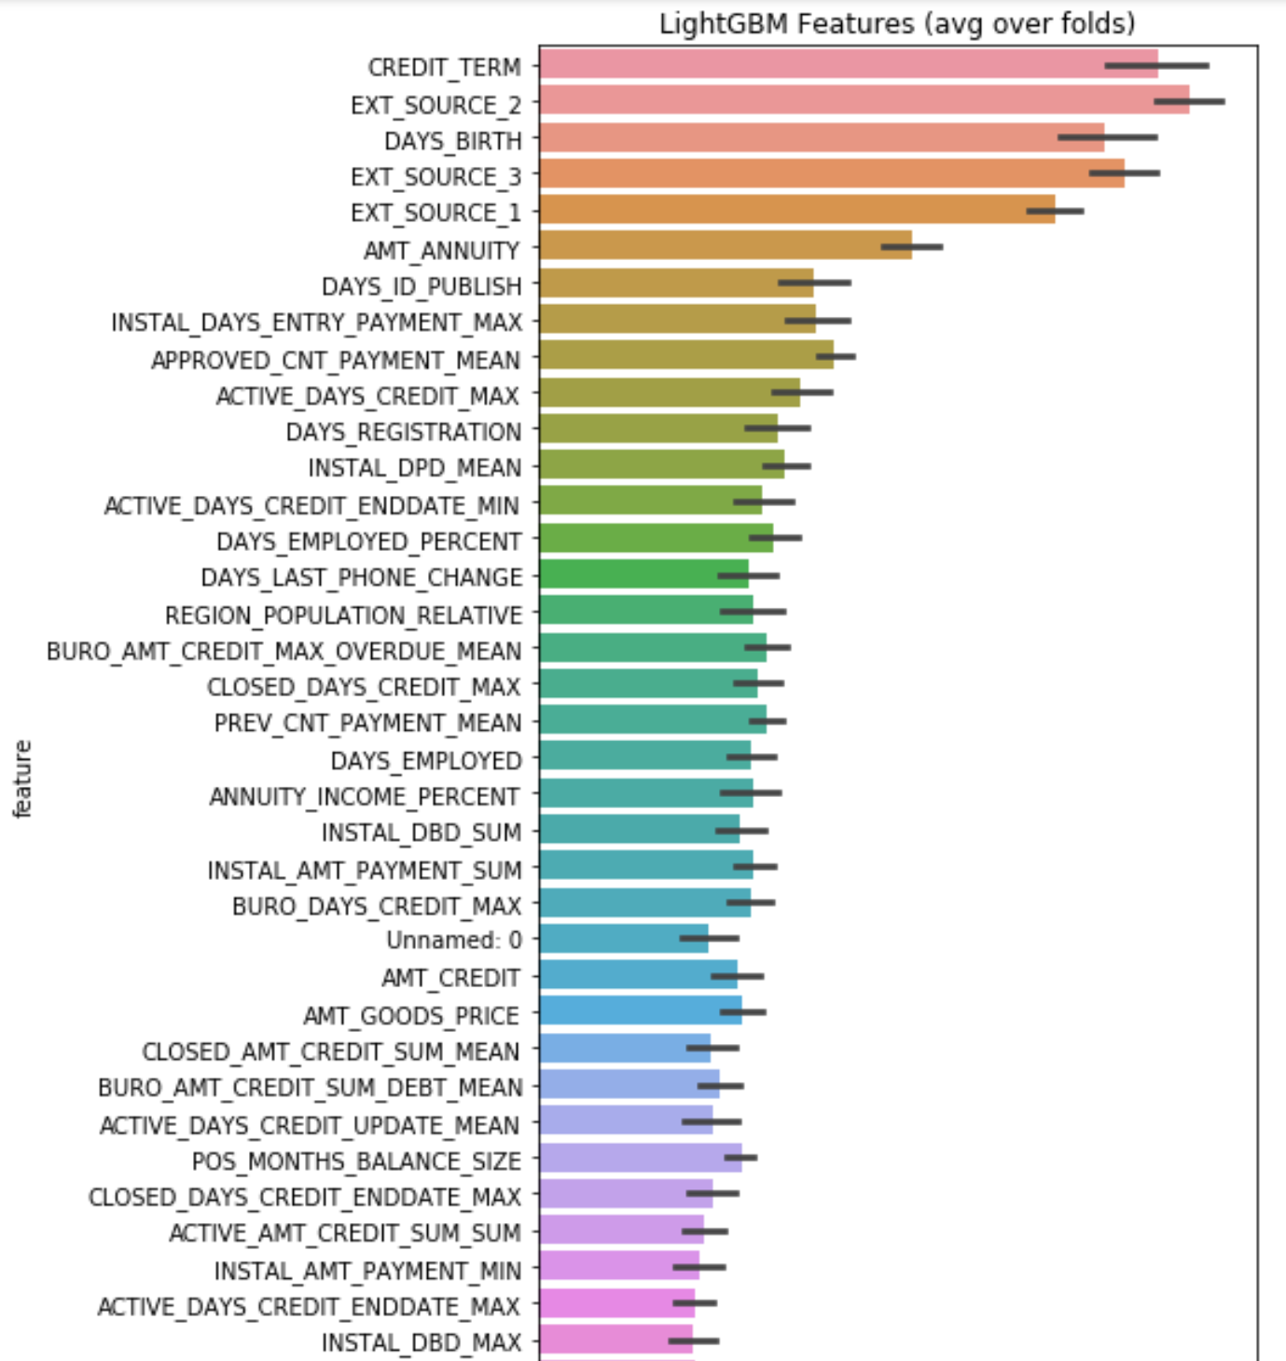
MODELING – LightGBM
(post feature engineering)

Slide 29
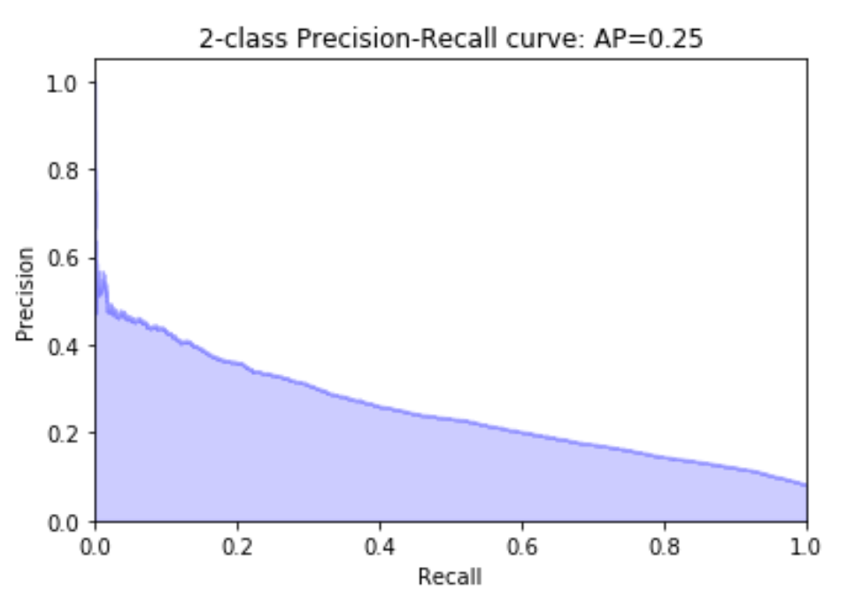
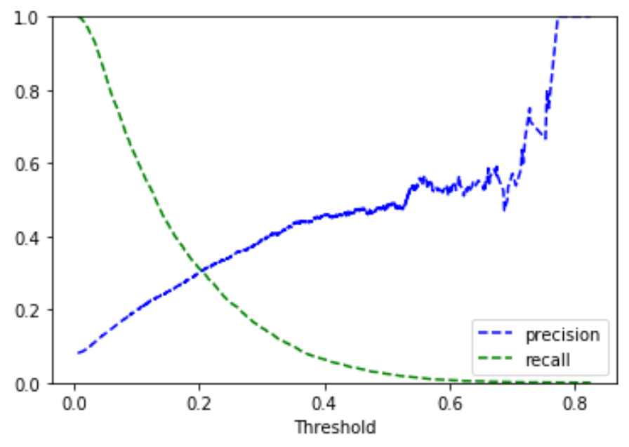
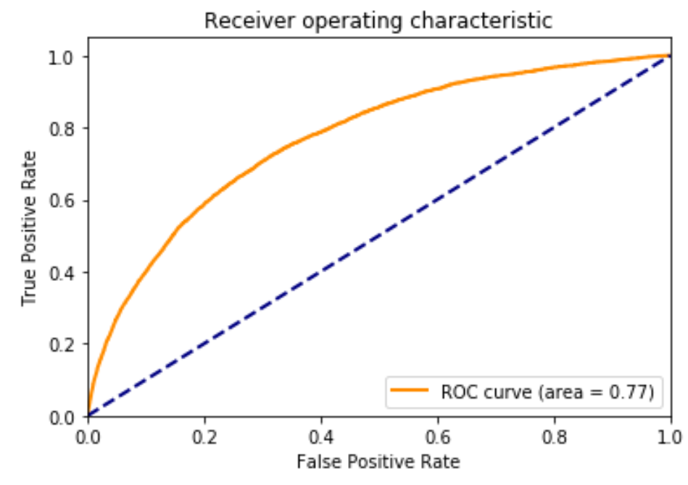
MODELING – LightGBM
(post feature engineering on Application data)
Metrics | Model Performance
Full Training score | 0.766
Full Testing score | 0.770
Average Precision Score | 0.25
Accuracy Score | 0.92
True vs. Pred | PP | PN
TP | 56,139 | 230
TN | 4,739 | 216

Slide 30
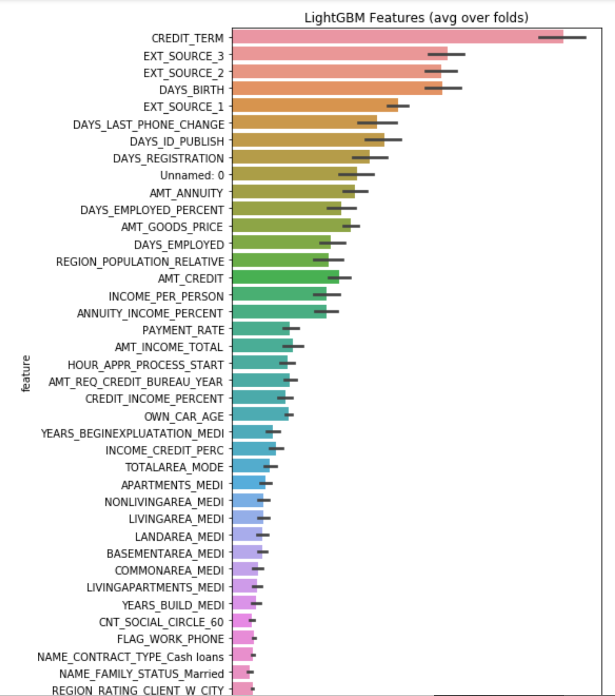
MODELING – LightGBM
(post feature engineering on Application data)

Slide 31
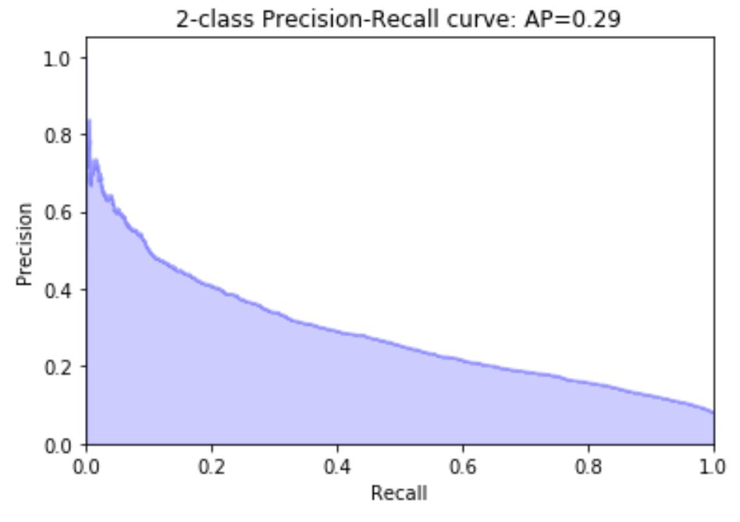
MODELING – LightGBM
(pre feature engineering)
Metrics | Model Performance
Full Training score | 0.7893
Full Testing score | 0.7899
Average Precision Score | 0.29
Accuracy Score | 0.92
True vs. Pred | PP | PN
TP | 56,241 | 352
TN | 4,526 | 420

Slide 32
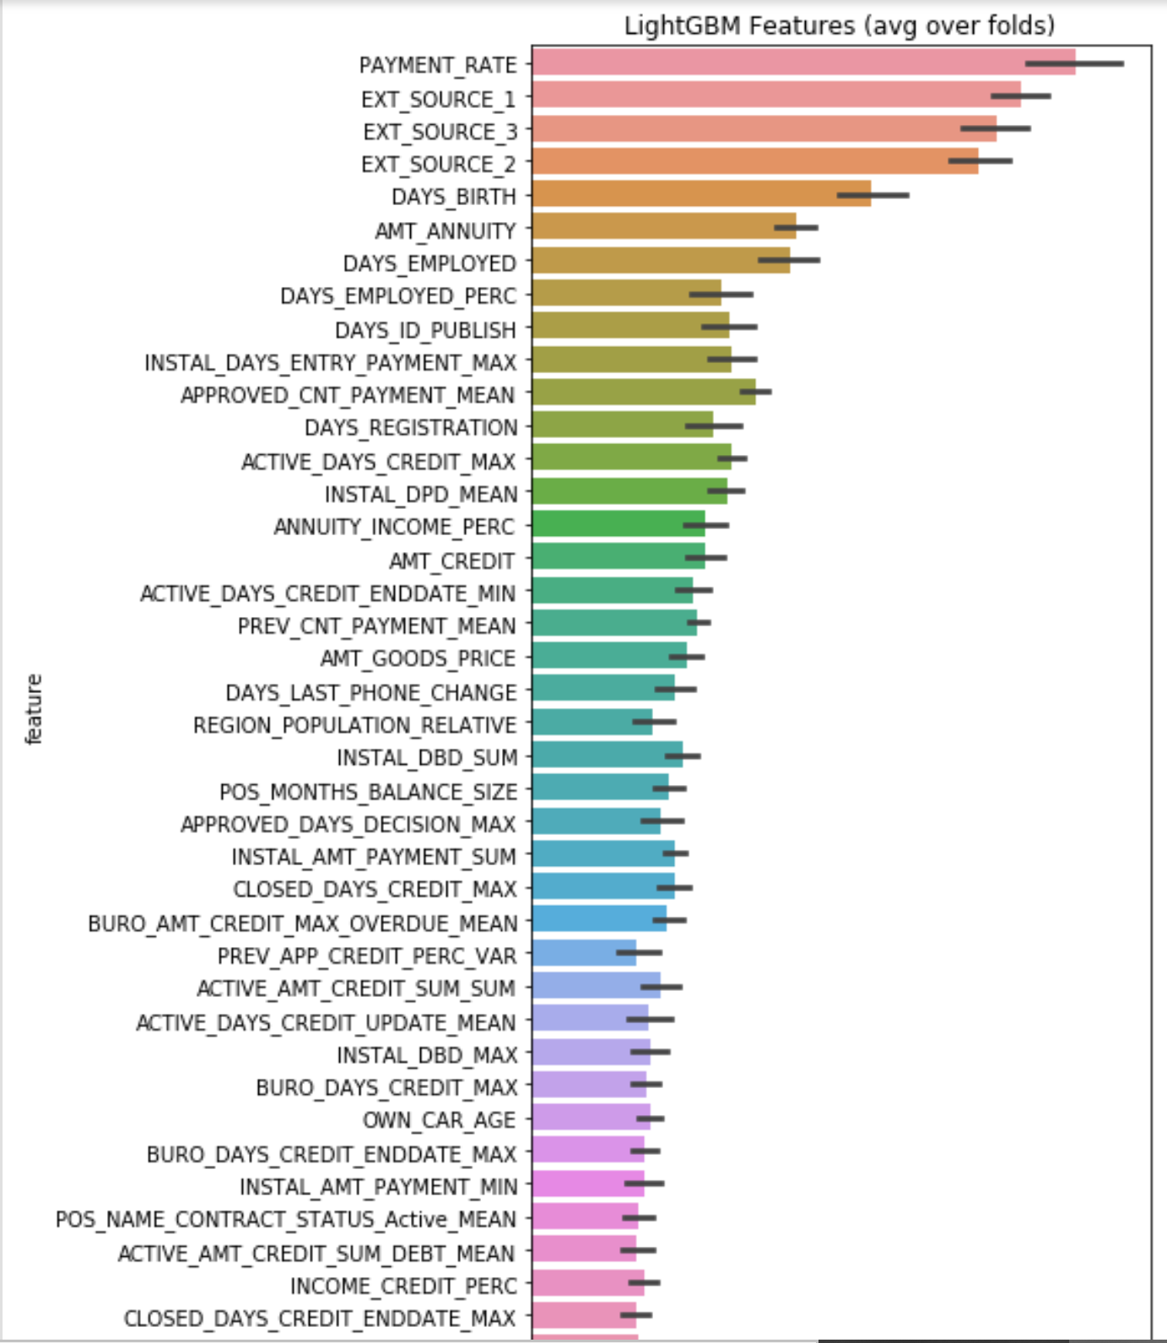
MODELING – LightGBM
(pre feature engineering)

Slide 33
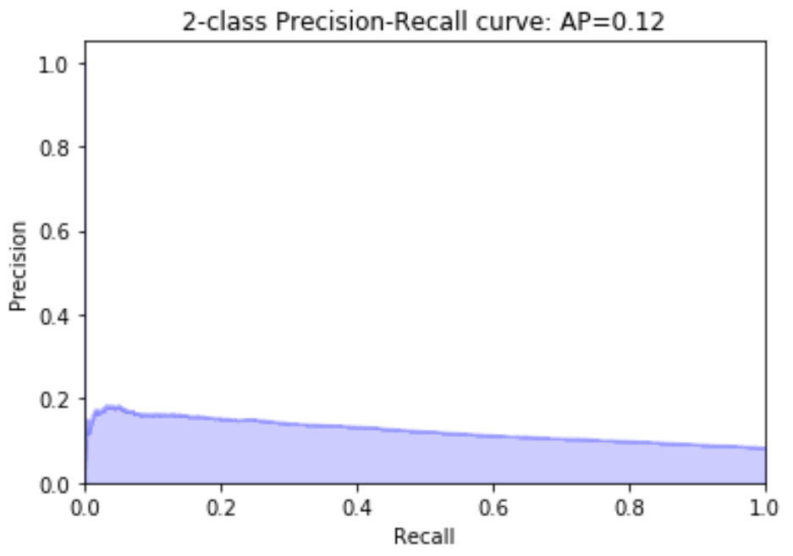
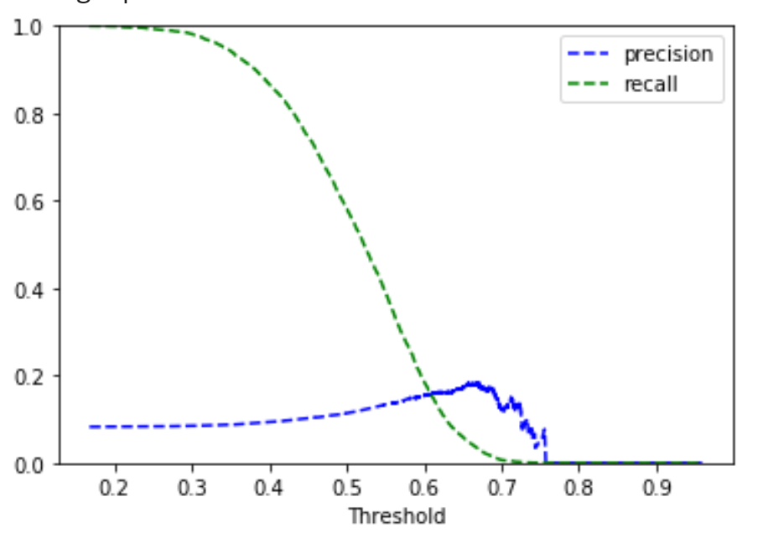
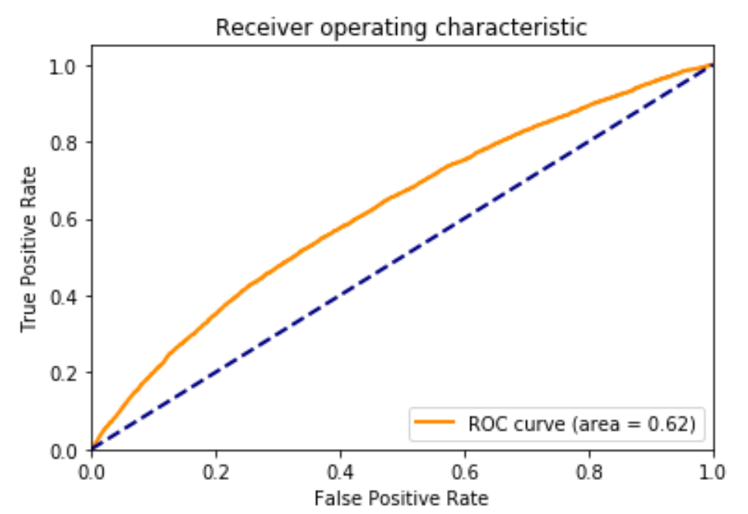
MODELING - Logistic Regression
Metrics | Model Performance
Full Training score | 0.591
Full Testing score | 0.592
Average Precision Score | 0.12
Accuracy Score | 0.59
True vs. Pred | PP | PN
TP | 33,560 | 23,042
TN | 2,129 | 2,957

Slide 34
MODELING – Comparison
(Performance Metrics)
Metrics | Post feature engineering | Post feature engineering (App) | Pre feature engineering | Logistic
Full Training score | 0.788 | 0.766 | 0.7893 | 0.591
Full Testing score | 0.791 | 0.770 | 0.7899 | 0.592
Average Precision | 0.28 | 0.25 | 0.29 | 0.12
Accuracy Score | 0.92 | 0.92 | 0.92 | 0.59
True vs. Pred
TP
TN
PP | PN
56,216 | 392
4,490 | 411
PP | PN
56,139 | 230
4,739 | 216
PP | PN
56,241 | 352
4,526 | 420
PP | PN
33,560 | 23,042
2,129 | 2,957

Slide 35
Results & Insights
Post Feature Engineering with all data
Post Feature Engineering with only application data
Pre Feature Engineering with all data

Slide 36
Questions?

